Slide 1
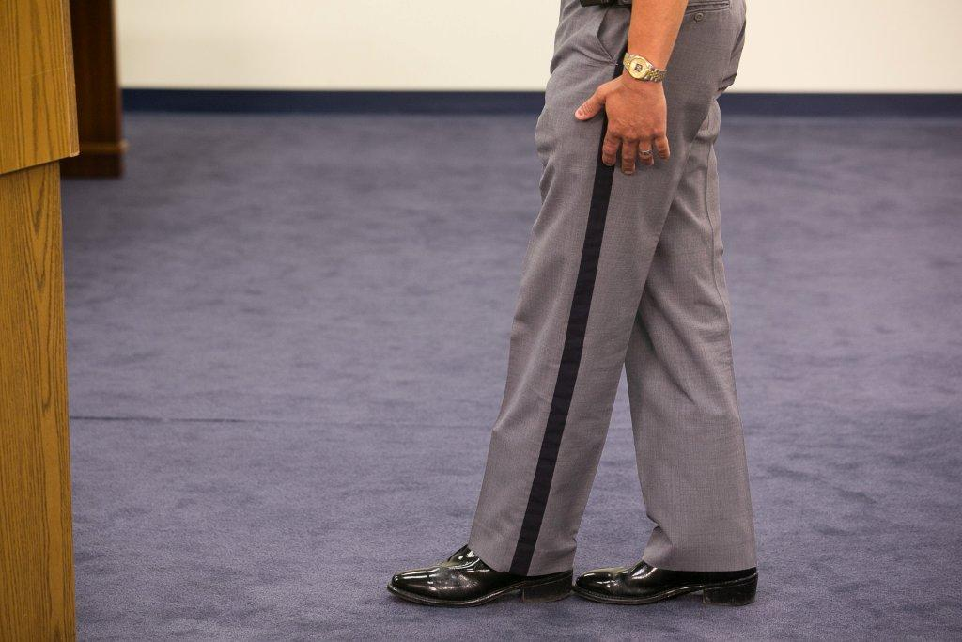
Session 13
Alcohol Workshop:
Second Session

Slide 2
Learning Objectives
Properly administer SFSTs
Properly observe and record subject’s performance utilizing field note-taking guide
Properly interpret subject’s performance

Slide 3
Administer SFSTs
Volunteers who have consumed alcohol
Each team member will administer one complete series of tests to at least one drinking volunteer
Each team prepares a descriptive, written test record on each volunteer tested

Slide 4
Hands On Practice

Slide 5
Session Wrap Up
SFST results on each volunteer
Observations concerning the relationship between volunteers' BACs and their performances on the tests

Slide 6
Questions?

